Slide 1
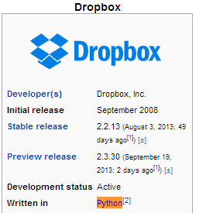
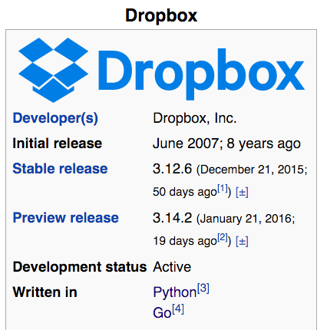
Motivation

Slide 2

Motivation
Star Wars special effect team use Python to glue tools using various programming languages

Slide 3
Outline
Why Python?
Installation
Python
Notepad++
Basic Intro
Variables and operators
Control flow
If-else; for; while;
Data Structure
Tuple, list, dictionary
MySQL
Installation
Create, populate, and query tables
Project of fetching data from yelp.com

Slide 4
Why Python?
It’s open source software
Free to use
Source code is accessible
Online community is huge
Platform independent
Powerful
Dynamic typing (check type at run time)
Built-in types and functions
Library utilities
Third party utilities (scikit-learn, SciPy, NumPy)
Automatic memory management

Slide 5
Installation
IPython (Jupyter) Notebook by installing Anaconda
Integrated Development Environment (IDE) I recommend: PyCharm

Slide 6
Python tutorial
Numbers
Strings
List
Dictionary

Slide 7
Numbers
No need to specify the variable type before using it
The equal sign ('=') is used to assign a value to a variable
the last printed expression is assigned to the variable _

Slide 8
Strings
Enclosed in single quotes, double quotes, triple quotes.
Index and slice of strings.

Slide 9
List
Comma-separated items between square brackets
List items need not all have the same type
Mutable elements
Very versatile

Slide 10
comparison operators
< (less than)
> (greater than)
== (equal to)
<= (less than or equal to)
>= (greater than or equal to)
!= (not equal to)

Slide 11
Fibonacci series
Indentation is Python’s way of grouping statements, no more {}
As long as it’s consistent in the program, Python interpreter can understand it. It can at least one space, or at least one tab (4 spaces is preferred)

Slide 12
Control flow
if
while
for

Slide 13
Function
Define and use a function
Fibonacci series up to n

Slide 14
More about List
map function
list comprehension

Slide 15
dict
Unordered set of key: value pairs

Slide 16
MySQL
Install MySQL client following this link.
Download the documentation here.
Connect to MySQL using the root password you set during the installation

Slide 17
Access tables
Database-> Table
Create database test1
Choose this database by using “use” command
Create table to store data.

Slide 18
create table example(
id int not null,
name varchar(30),
age tinyint,
primary key(id));
The word "example" is the name of our table, as it came directly after "CREATE TABLE". It is a good idea to use descriptive names when creating a table, such as: employee_information, contacts, or customer_orders. Clear names will ensure that you will know what the table is about when revisiting it a year after you make it.

Slide 19
create table example(
id int not null,
name varchar(30),
age tinyint,
primary key(id));
Here we create a column "id" that is not null and belongs to int data type.

Slide 20
create table example(
id int not null,
name varchar(30),
age tinyint,
primary key(id));
Reserved MySQL Keywords: Here are a few quick definitions of the reserved words used in this line of code:
INT - This stands for integer or whole number. 'id' has been defined to be an integer.
NOT NULL - These are actually two keywords, but they combine together to say that this column cannot be null. An entry is NOT NULL only if it has some value, while something with no value is NULL.

Slide 21
create table example(
id int not null,
name varchar(30),
age tinyint,
primary key(id));
Here we make a new column with the name "name"! VARCHAR stands for "variable character". "Character" means that you can put in any kind of typed information in this column (letters, numbers, symbols, etc). It's "variable" because it can adjust its size to store as little as 0 characters and up to a specified maximum number of characters.
We will most likely only be using this name column to store characters (A-Z, a-z). The number inside the parentheses sets the maximum number of characters. In this case, the max is 30.

Slide 22
create table example(
id int not null,
name varchar(30),
age tinyint,
primary key(id));
Our third and final column is age, which stores an tiny integer. The possible integer values that can be stored in an “TINYINT" are -128 to 127, which is enough to store someone's age!
Notes:
Tinyint unsigned

Slide 23
create table example(
id int not null,
name varchar(30),
age tinyint,
primary key(id));
PRIMARY KEY is used as a unique identifier for the rows. Here we have made "id" the PRIMARY KEY for this table. This means that no two ids can be the same, or else we will run into trouble. This is why we made "id" an auto-incrementing counter in the previous line of code.

Slide 24
Import data
Import text file into database for processing
Query data

Slide 25
Recommended Recourse
Google Python Class
One Python book
One MySQL book

Slide 26
Memo
Database normalization (course registering)
Connect MySQL from Python(next seesion)

Slide 27
Database Normalization
Course schedule
Use example to illustrate sub-query

Slide 28
Student ID | Student Name | Class Number | Class Title
1001 | Manmohan Aseri | MIS 7310 | Advanced Topics in Knowledge Management
1001 | Manmohan Aseri | OPRE 7330 | Deterministic Models in Operations Research
1001 | Manmohan Aseri | MIS 7420 | Seminar in Management Information Systems
1002 | Cheng Nie | MIS 7310 | Advanced Topics in Knowledge Management
1002 | Cheng Nie | MATH 5301 | Elementary Analysis I
1002 | Cheng Nie | MIS 7420 | Seminar in Management Information Systems
1003 | Danish H. Saifee | MIS 7310 | Advanced Topics in Knowledge Management
1003 | Danish H. Saifee | OPRE 7330 | Deterministic Models in Operations Research
1003 | Danish H. Saifee | MIS 7420 | Seminar in Management Information Systems
……..
Student_Course
What are the course titles that Cheng Nie registered for?
Student ID | Class Number
1001 | MIS 7310
1001 | OPRE 7330
1001 | MIS 7420
1002 | MIS 7310
1002 | MATH 5301
1002 | MIS 7420
1003 | MIS 7310
1003 | OPRE 7330
1003 | MIS 7420
select ctitile from Course where cnumber
in (select cnumber from Student_Course where sid
in (select sid from Student where sname=“Cheng Nie”));
Student
Course
Student ID | Student Name
1001 | Manmohan Aseri
1002 | Cheng Nie
1003 | Danish H. Saifee
Class Number | Class Title
MIS 7310 | Advanced Topics in Knowledge Management
OPRE 7330 | Deterministic Models in Operations Research
MIS 7420 | Seminar in Management Information Systems
MATH 5301 | Elementary Analysis I
Notes:
Add example into DB, and join the data to show the big table.

Slide 29
Connect to MySQL from Python
The meaning of ‘u’ and ‘b’ prefix.
Tuple with one element: (u'10years',)
http://dev.mysql.com/doc/refman/5.6/en/integer-types.html

Slide 30
HW6

Slide 31
Useful topics
Text formatting
Regular expression
Debug in python
Modules (csv, html, cPickle, re)

